Slide 1
Politecnico di Milano
Computer Music: Languages and Systems
A.Y. 2022/2023
HW3
DESIGN AND IMPLEMENTATION OF A COMPUTER MUSIC SYSTEM
Group #11 – Power Rangers
Emma Coletta
Federico Ferreri
Lorenzo Previati

Slide 2
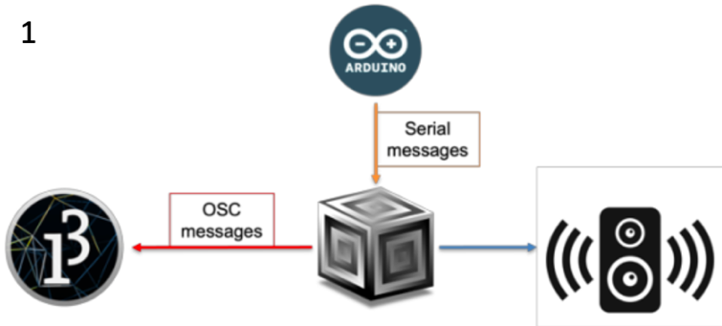
Introduction and System Description
Purpose of the final system: frequency modulation of a synthesizer controlled by a gray scale photosensitive sensor.
Implementation scheme:
Interaction music system → Arduino Uno;
Computer music unit → Supercollider;
Graphical feedback unit → Processing.
Tools:
Digital push button;
Analog gray scale sensor;
Arduino UNO board.
Arduino board settings:
Digital push button: charged at 3.3V;
Analog gray scale sensor: charged at 5V.
The digital push button has the simple task of activating or stopping or synthesizer from playing. If the numerical value representing the activation state is ≠0, the program works on frequency modulation.
We exploited the ability to measure the intensity of light of the gray scale sensor to decide on which frequency the synthesizer would play.
Notes:
For the implementation of our music system, we chose to use the first among the suggested possible schemes: using Arduino UNO as our control device, we share information to SuperCollider with serial messages providing the feedback events to Processing (our graphical feedback unit) with OSC messages.
Frequency modulation happens depending on the amount of light caught by the gray scale sensor, resulting in a change of pitch of the playing synth.

Slide 3
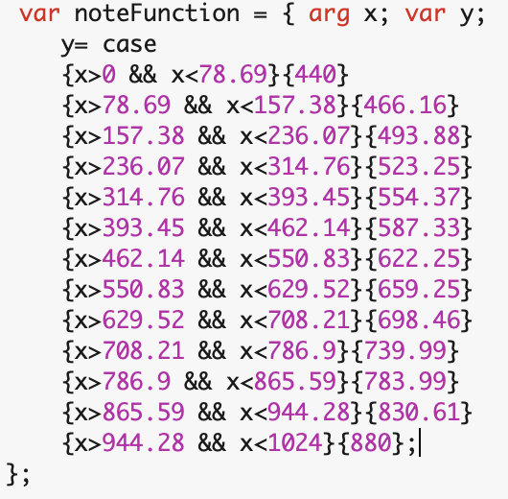
Notes on SuperCollider code
We open the communication with the serial port to which the Arduino Board is connected;
We store in an array the values caught by the gray scale sensor (from Arduino);
Definition of a Synth object (initially not playing);
Creation of a control routine that sets the frequency for the synth.
Value range caught by the gray scale sensor:
from 0 to 1024 (max. brightness condition)
Chosen frequency modulation range:
from 440Hz to 880Hz
← function mapping between the values caught by the sensor and a set frequency value for the synth

Slide 4
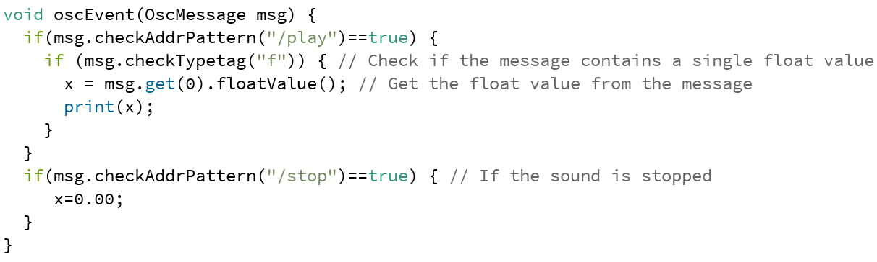
Notes on Processing code
Processing: used to create a visual representation of sound exploiting a noise animation.
oscEvent(): event handler for OSC messages;
It checks for specific OSC address patterns (“/play” and “/stop”) and extracts the frequency value of the synth from the message, saving it in variable x.
draw() function → handles the animation of the visual representation of sound.
How the animation works:
The code checks the value of x to determine the frequency of the sound being played. Based on the frequency value, the level1 and level2 variables are set to determine the range of y-values for the shape being drawn. Each frequency corresponds to a different range of y-values.
Another variable, yoff, controls the vertical movement of the noise animation.
Notes:
yoff: variable used to control the vertical movement of the noise animation;
xoffIncrement and yoffIncrement: amount by which xoff and yoff variables vary in each frame of the animation;
level1 and level2: used to determine the range of y-values for the shape being drawn.

Slide 5

Thank You.

